Slide 1


Slide 2



Slide 3
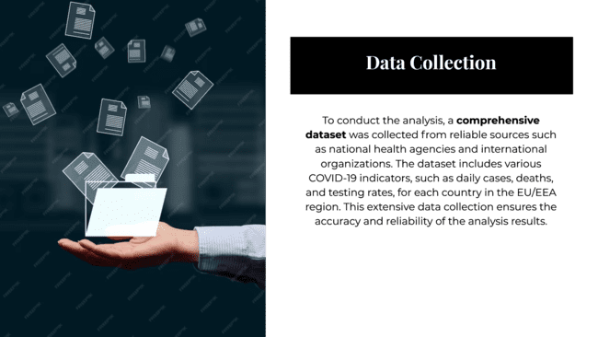

Slide 4
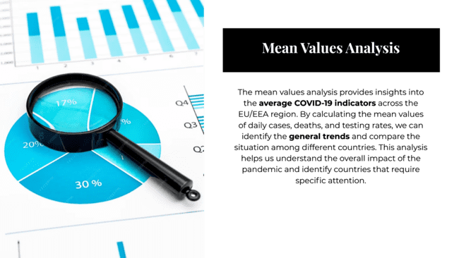

Slide 5
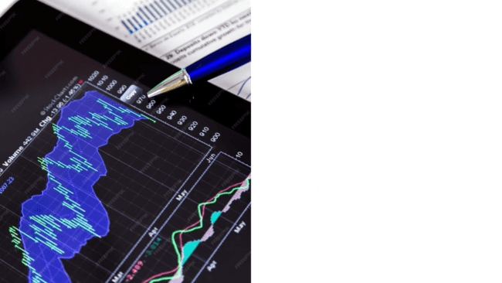

Slide 6
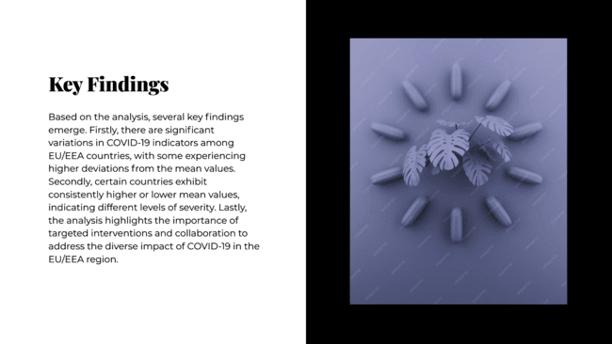

Slide 7
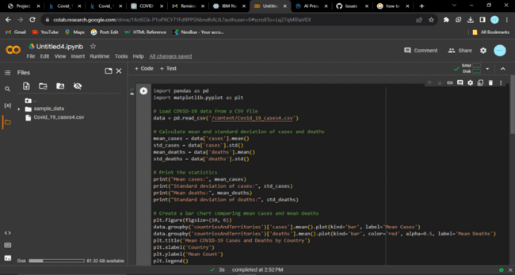
1.Analysis Objectives: Define the specific objectives of analyzing COVID-19 cases and deaths data, such as comparing mean values and standard deviations.

Slide 8
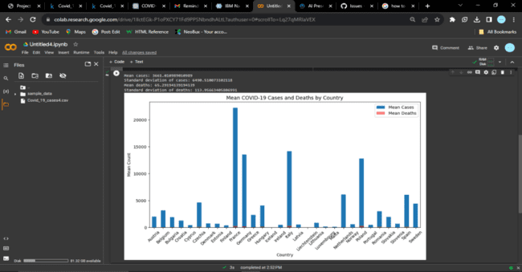
output

Slide 9
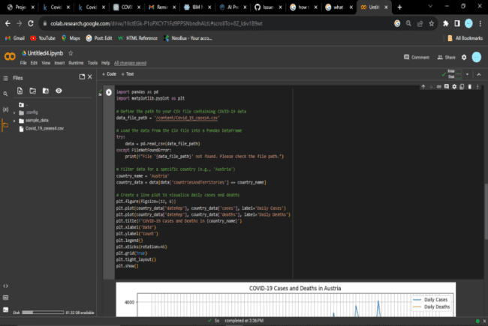
2.Data Collection: Obtain the provided data file containing COVID-19 cases and deaths information per day and by country in the EU/EEA.

Slide 10
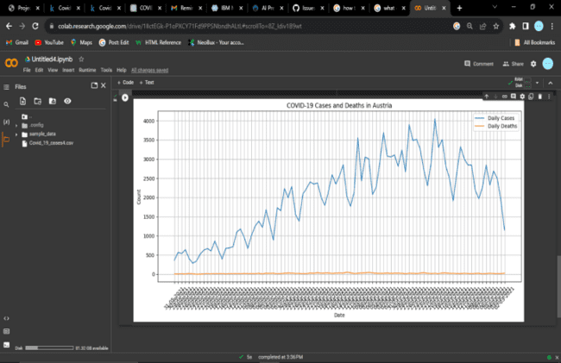
output

Slide 11
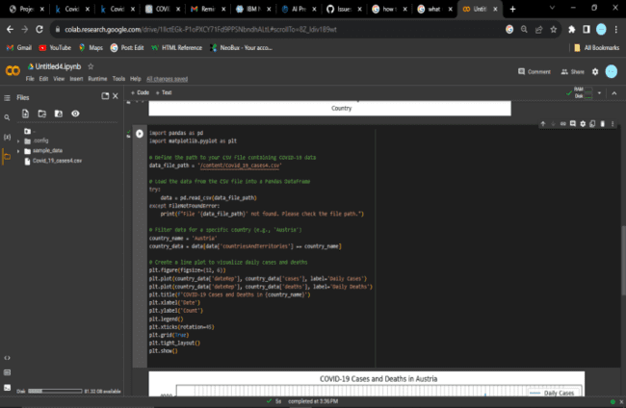
3.Visualization Strategy: Plan how to visualize the mean values and standard deviations using IBM Cognos to create informative charts and graphs.

Slide 12
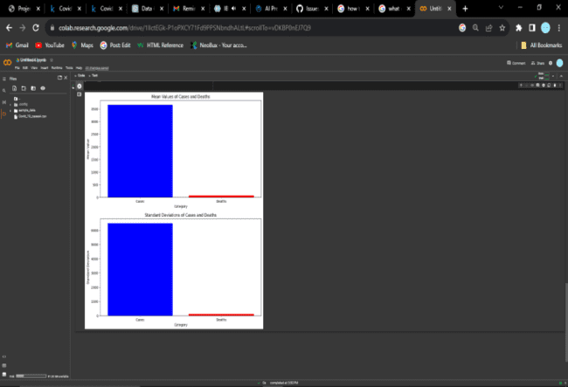
output

Slide 13
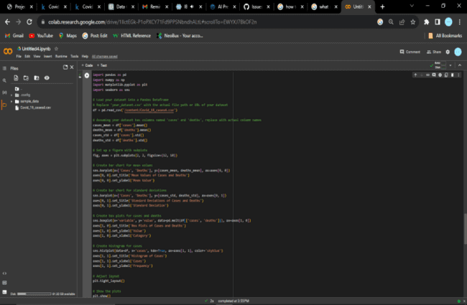
4.Insights Generation: Identify potential insights from the comparison of mean values and standard deviations of cases and deaths.

Slide 14
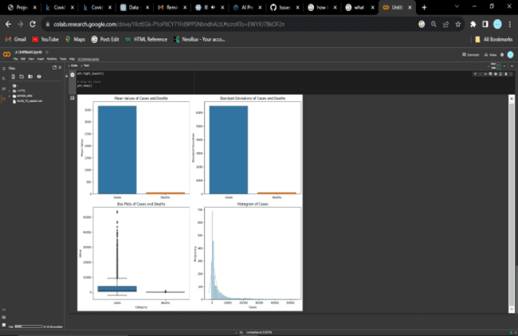
output

Slide 15
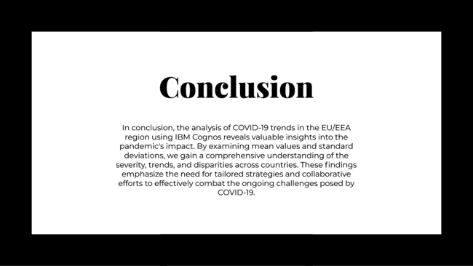

Slide 16


